Slide 1

CREDIT CARD FRAUD DETECTION

Slide 2
Abstract
Owing to the rise in fraud that costs money all over the world, a number of approaches and
strategies have been created for identifying fraud. In order to identify harmful user behaviour,
fraud detection entails examining user activity. The word "malicious behaviour" covers a wide range of actions, such as fraud, delinquency, intrusion, and account defaulting.
In the proposed work, we use logistic regression, a machine learning algorithm, to analyse
credit card fraud detection.

Slide 3
What is credit card fraud?
What credit card fraud detection does?
When someone makes a transaction using your credit card or credit account that you did not authorise, it is known as credit card fraud. This behavior can occur in a number of ways. For example, your credit card may be used to make purchases or other activities in person or over the internet if it is lost or stolen.
Modelling previous credit card transactions with knowledge about the ones that turned out to be
fraudulent is one aspect of the credit card fraud detection challenge. The next step is to apply this model
to determine the fraud status of a new transaction. Our goal is to identify as many fraudulent transactions
as possible while reducing the number of false positives.

Slide 4

Problem Statement
The difficulty lies in identifying fraudulent credit card transactions so that credit card firms’
consumers are not charged for goods they did not buy.

Slide 5
Some important terms:
• True Positives: Fraud instances that the model correctly identified as fraudulent.
• False Positive: The instances that weren't fraud but were labelled as such by the model.
• True Negative: The instances of non-fraud that the model correctly identified as "non-fraud."
• False Negative: Fraud situations classified as "non-fraud" by the model.
• Accuracy: The ratio of fraud transactions labelled as fraud and non-fraud transactions classified as non-fraud to the total number of transactions in the test data represents the accuracy of the model's predictions.
• Sensitivity: The ratio of accurately identified fraud instances to total fraud cases is known as sensitivity,
recall, or true positive rate.
• Specificity: The ratio of accurately detected nonfraud cases to the total number of nonfraud cases is
known as Specificity, or True Negative Rate.

Slide 6
Fraud Detection and process
• Its a process of identifying fraudulent transaction.
This technique used to recognize fraudulent credit card transactions so that customers are not charged for items that they did not purchases

Slide 7
ABOUT DATASET
we gathered the data from Kaggle (https://www.kaggle.com/mlgulb/creditcardfraud)
It has 32 variables and 284807 observations
class is used as the factor variable
v1 to v28 are the transactions
Amount denotes the amount of transaction
Class is the factor variable ( 0 denotes legit transaction and 1 denotes fraud detection)
Time is the time of transaction

Slide 8
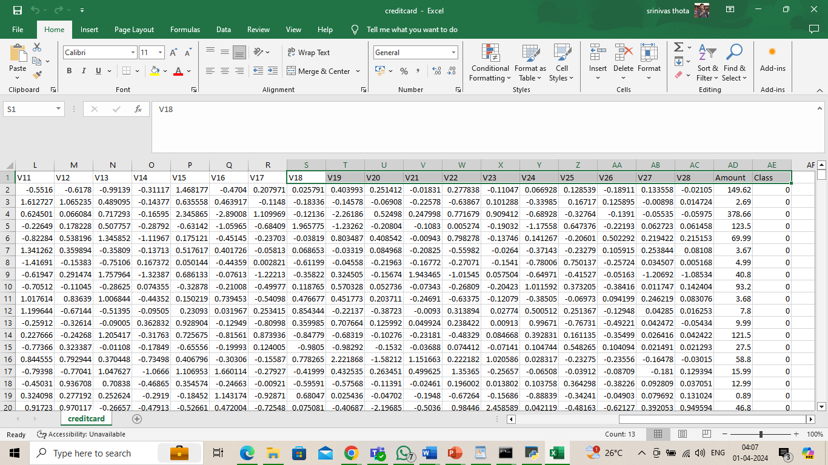

Slide 9
Algorithm Used
Logistic Regression
Logistic regression is one of the most popular machine learning algorithms, which comes under the supervised learning technique. it is used for predicting the categorical dependent variable using a given set of independent variables. Logistic regression is a significant machine learning algorithm because it has the ability to provide probabilities and classify new data using continuous and discrete datasets.

Slide 10
Advantages
The results obtained by the logistic regression algorithm is best compared to any other algorithms.
Logistic regression is a robust ml algorithm that work efficiently even at solving a very complex problem with 95% accuracy.
logistic regression outputs well-calibrated probabilities along with classification results. This is an advantage over models that only give the final classification as results.

Slide 11

Technology used

Slide 12
Modules
Frame the problem • collect the row data • importing libraries numpy, sklearn , pandas etc. • process the data for analysis 1. perform the logistic regression on data 2.explore the data • perform in-depth analysis • communicate results of the analysis

Slide 13
System Requirements
software requirements system requirements • os: windows or linux • pythin ide:python 3.6 • jupyter notebook and related libraries • Hardware requirements • processor : i3 • hardware : 5gb • memory : 1gb

Slide 14
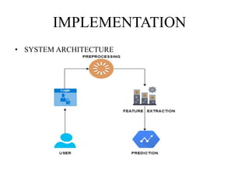

Slide 15
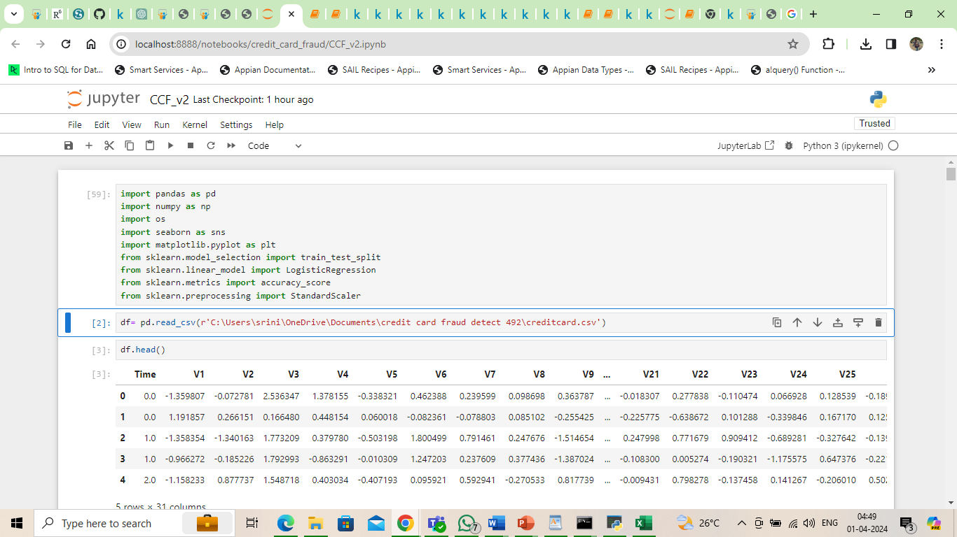

Slide 16
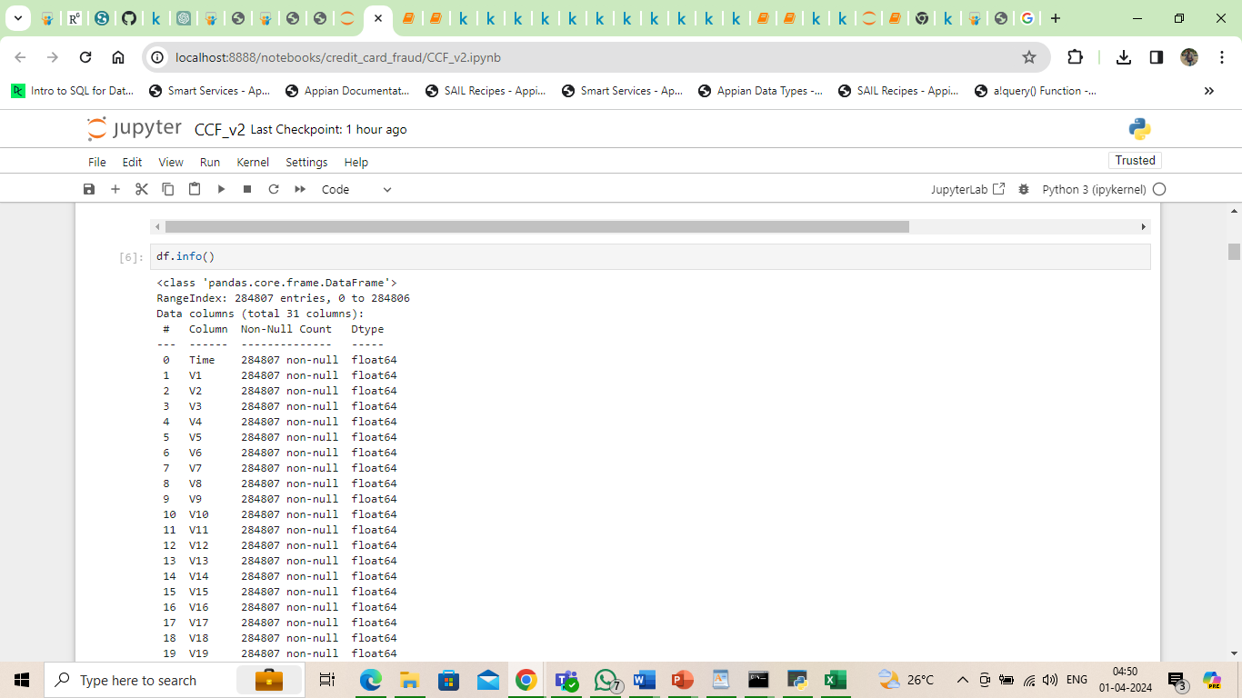

Slide 17
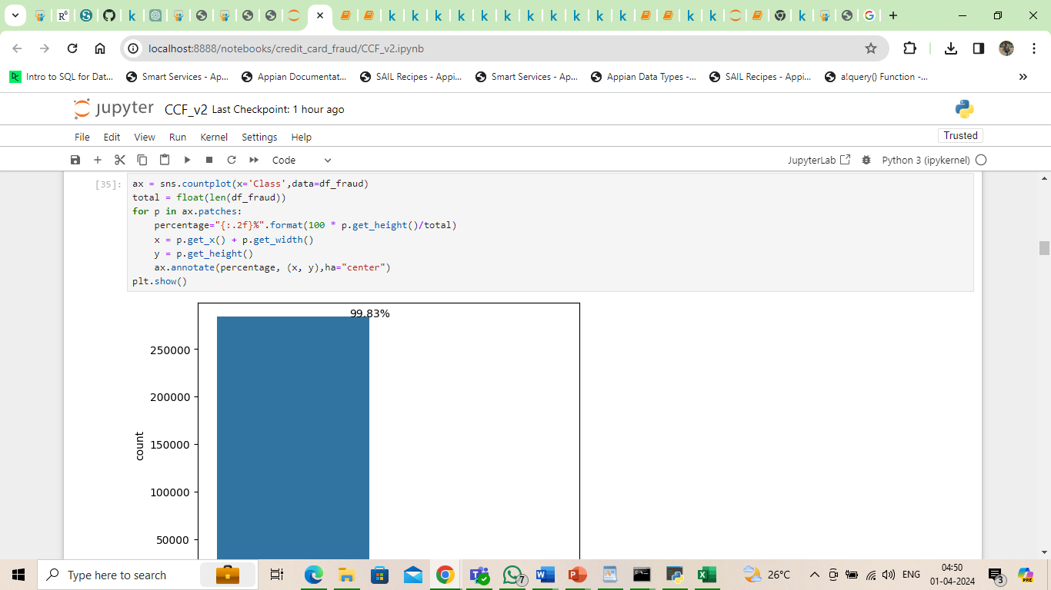

Slide 18
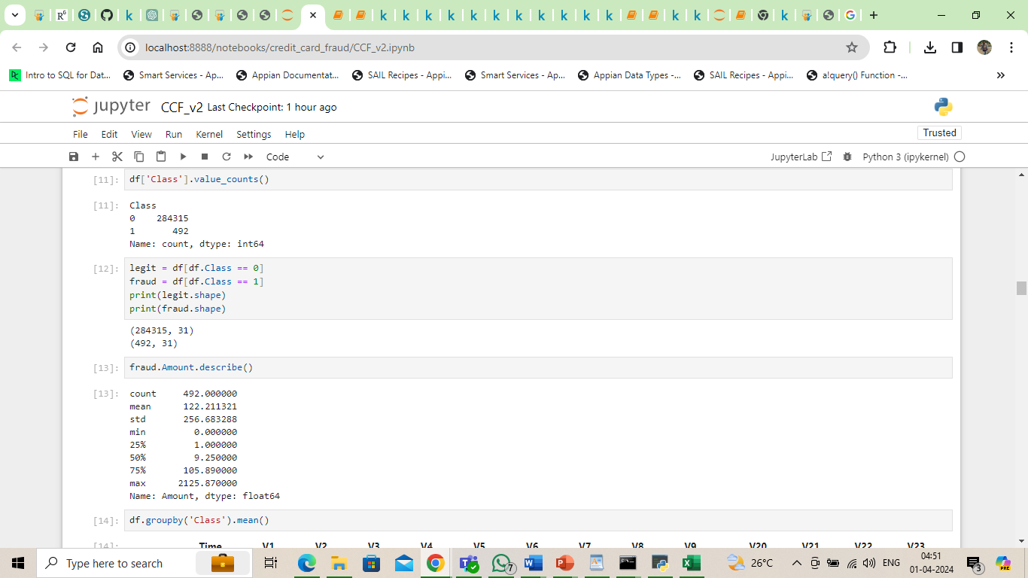

Slide 19
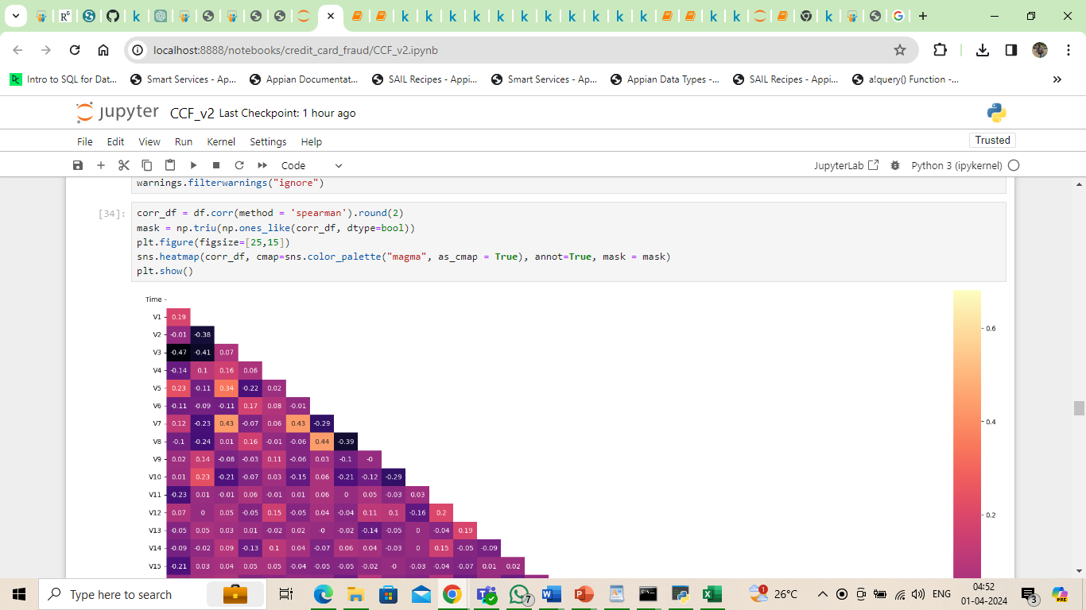

Slide 20
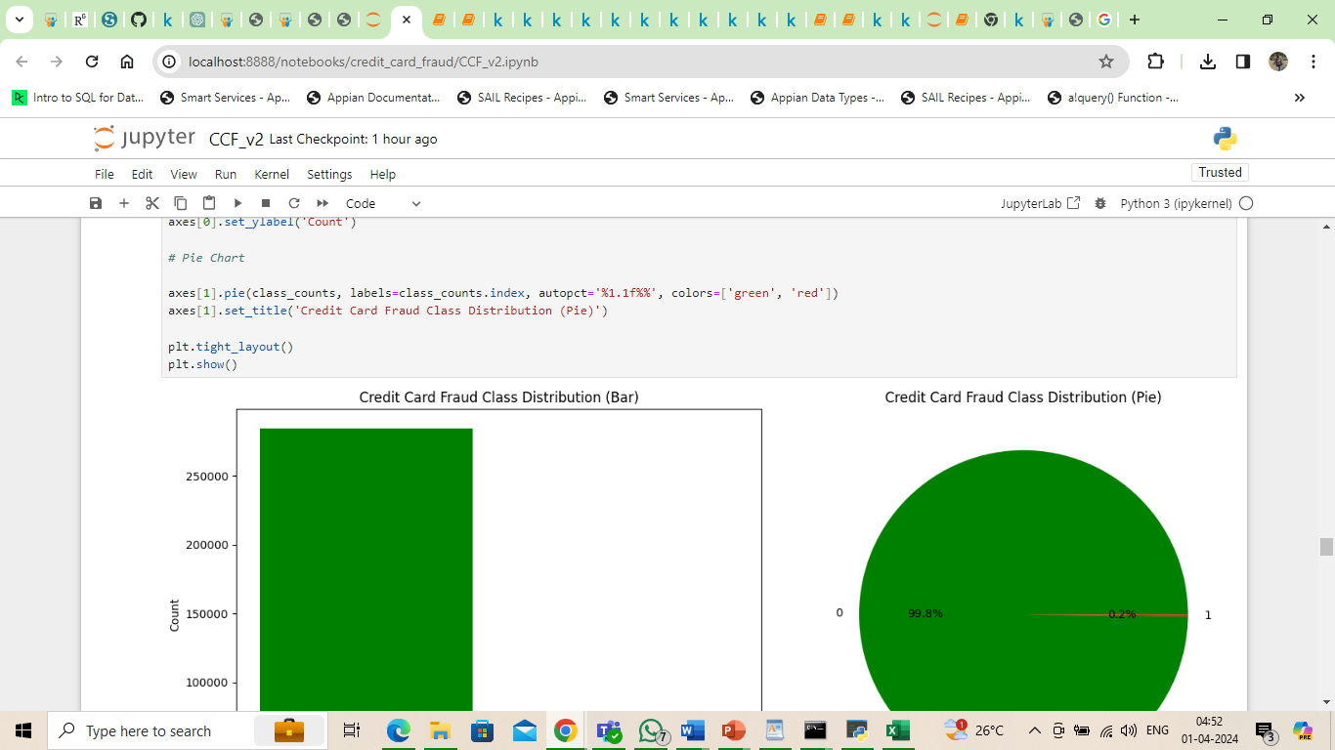

Slide 21
Conclusion & Future Scope
Testing accuracy= 94.26%
Fraud detection system have become essential for banks and financial institution to minimize their losses. However ,there is a lack of published literature on credit card fraud detection techniques, due to the unavailable credit card transaction dataset for researches.
we designed a system to detect fraud in credit and transaction. this system is capable of providing most of the essential features required to detect fraudulent and legitimate transactions.
The dataset available on the day to day processing may become outdated, it is necessary to have updated data for effective fraud behavior identification.

Slide 22
THANK YOU!!

